Slide 1
In-Database Analytics for NoSQL Key-Value Stores
Dylan Hutchison, 5 December 2016
Advisors: Bill Howe, Dan Suciu

Slide 2

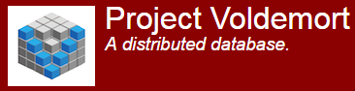








Tons of NoSQL Key-Value Stores!
Microsoft Azure
DocumentDB
Notes:
What is a NoSQL Key-Value Store? Here's a bunch of examples.

Slide 3
Who uses a K-V DB? How?
Basho Riak Use Cases
➔ Find a "natural key" for your application
DATA TYPE | KEY | VALUE
Session | User/Session ID | Session Data
Content | ID | Documents, Images, Posts, Videos, Texts, JSON/HTML, etc.
Advertising | Campaign ID | Ad Content
Logs | Date | Log File
Sensor | Date/Time | Sensor Updates
User Data | Login, Email, UUID | User Attributes
http://basho.com/products/riak-kv/
Notes:
So who uses these K-V DBs? Figure out a "natural key" for their application.

Slide 4
Who uses a K-V DB? How?
Timely – Time Series Event Monitoring
Row | ColumnFamily | ColumnQualifier | Value
sys.cpu.user\1447879348291 | host=r001n01 | instance=0,rack=r001 | 2.0
sys.cpu.user\1447879348291 | instance=0 | host=r001n01,rack=r001 | 2.0
sys.cpu.user\1447879348291 | rack=r001 | host=r001n01,instance=0 | 2.0
Compound key
Intentional order
Multiple values per key
Repeated values
Many tricks to encode information into K-Vs
https://nationalsecurityagency.github.io/timely/docs/#data-storage-example
Notes:
for example, it's common to adopt a 'column family' to group related columns. And some applications (ab)use the column family to encode more information. In this case, we are monitoring racks, and they have encoded redundant information in multiple ways by piggybacking on column family. So things get complex in order to maximize performance. We want to model and reduce this complexity.

Slide 5
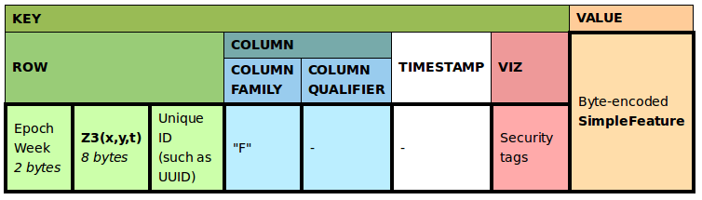
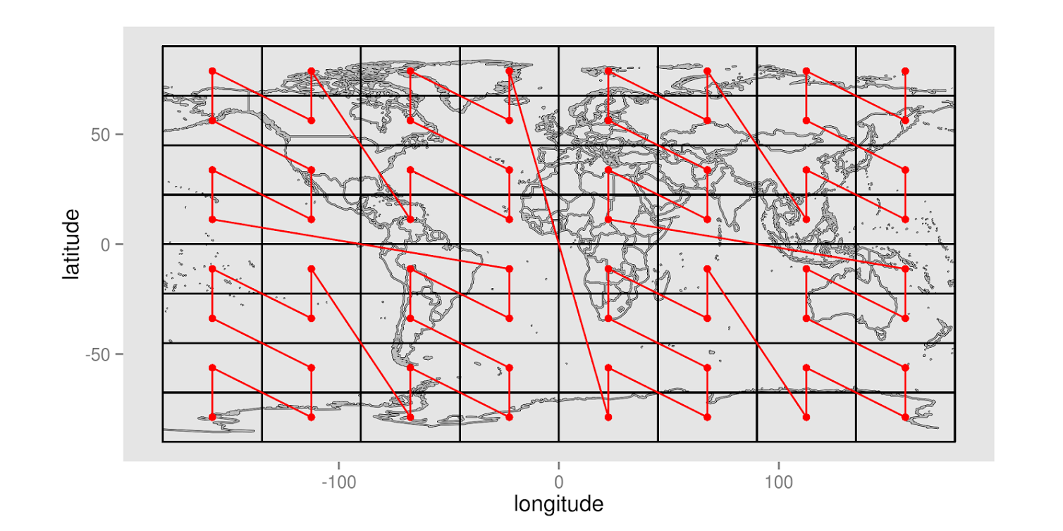
Who uses a K-V DB? How?
K-V encoding tricks can be arbitrarily complex
GeoMesa – Spatiotemporal Store
Hierarchical
Storage
Hash
Functions
+ Secondary or Full Indexes on Values
Notes:
Don't explain – there are more complicated ways to stuff information into key-value form. Applications choose their key-value encoding based on their concept of a "natural key" and how they query it.

Slide 6
Why use K-V stores?
Scale out – large commodity clusters
Transparent partitioning, layout, performance
Friendly to developers & applications that want control
Some have "special features"
entry-level access control
Simple solution, if all your application requires is to read & write entries by key

Slide 7
Why use K-V stores?
Scale out – large commodity clusters
Transparent partitioning, layout, performance
Friendly to developers & applications that want control
Some have "special features"
entry-level access control
Simple solution, if all your application requires is to read & write entries by key
What if you want to do more?
Computing beyond read-writes
Computing @application client
can have drawbacks…

Slide 8
Computing on Key-Value DB
Example from Riak Use Case: Browser Sessions (e.g. Wikipedia)
DATA TYPE | KEY | VALUE
Session | User/Session ID | Session Data (pages visited, shopping cart, …)
Fast read-writes perfect for low-latency web server
What if the website managers want to run analytics?
Simple
filters, aggs
Requires
re-shuffle
Requires
iteration
ML, matrix,
graph alg.
Notes:
The goal of this slide build is to illustrate analytical queries we might ask of a K-V store, beyond simple read-writes. I order the queries in increasing complexity.

Slide 9

Computing on Key-Value DB
Example from Riak Use Case: Browser Sessions (e.g. Wikipedia)
DATA TYPE | KEY | VALUE
Session | User/Session ID | Session Data (pages visited, shopping cart, …)
Fast read-writes perfect for low-latency web server
What if the website managers want to run analytics?
Query: find average session length.
Simple
filters, aggs
Requires
re-shuffle
Supported by most key-value databases
Requires
iteration
ML, matrix,
graph alg.
Notes:
E.g. wikipedia

Slide 10

Computing on Key-Value DB
Example from Riak Use Case: Browser Sessions (e.g. Wikipedia)
DATA TYPE | KEY | VALUE
Session | User/Session ID | Session Data (pages visited, shopping cart, …)
Fast read-writes perfect for low-latency web server
What if the website managers want to run analytics?
Query: find average session length.
Query: for each page, find average time spent viewing it.
Simple
filters, aggs
Requires
re-shuffle
Unsupported by most, unless you build an index
Need an external system
Requires
iteration
ML, matrix,
graph alg.
Notes:
E.g. wikipedia

Slide 11
Computing on Key-Value DB
Example from Riak Use Case: Browser Sessions (e.g. Wikipedia)
DATA TYPE | KEY | VALUE
Session | User/Session ID | Session Data (pages visited, shopping cart, …)
Fast read-writes perfect for low-latency web server
What if the website managers want to run analytics?
Query: find average session length.
Query: for each page, find average time spent viewing it.
Query: build a histogram of users browsing certain pages, grouped by session age, over various time periods.
Query: group users into clusters based on pages browsed. Recommend users to browse popular pages browsed in their cluster.
Simple
filters, aggs
Requires
re-shuffle
Requires
iteration
ML, matrix,
graph alg.
Notes:
E.g. wikipedia

Slide 12
Computing on Key-Value DB
State of the Art
Simple
filters, aggs
Supported inside K-V DBs, to various extents
Requires
re-shuffle
Requires
iteration
or: Pull data into an external serial (application client) or distributed (MapReduce, Spark, Presto, …) system
ML, matrix,
graph alg.
Notes:
You can either do the computation inside the database, or you can do the computation outside the database in an external system.

Slide 13

Computing on Key-Value DB
This Talk
Simple
filters, aggs
New support inside K-V DBs
Requires
re-shuffle
Requires
iteration
RACO
or: Pull data into an external serial (application client) or distributed (MapReduce, Spark, Presto, …) system
ML, matrix,
graph alg.
How to implement analytics in K-V DBs?
When is it good to do so?
Consider: # of re-shuffles, access path, selectivity, …
Notes:
(if the computation aligns with the key-value access path)
Flip back and show how first aligns with access path and the second does not.

Slide 14
Computing on Key-Value DB
Benefits of Server-Side Computation
Data Locality
Save communication
Reuse infrastructure
One less system to adopt and maintain
Database features for free
Indexed access
Distributed execution
Notes:
Borrow the inside of the Canadian Rapper Drake.
Intuition into why the in-database approach might work at all.
(if the computation aligns with the key-value access path)
Flip back and show how first aligns with access path and the second does not.

Slide 15

Graphulo: Linear Algebra
for Apache Accumulo
or, conceptually, any Google BigTable-based K-V DB
Notes:
Hypertable
In this section I will introduce concepts related to BigTable and Accumulo's architecture. Please do stop me if I fail to review

Slide 16
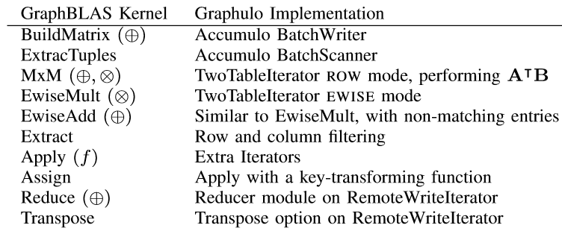
GraphBLAS: Working Spec for LA
for Sparse Matrices
Notes:
First I need to tell you what I mean by LA. MxM is the important operation.
Most other operations can be rewritten as MxMs, such as Extract.

Slide 17
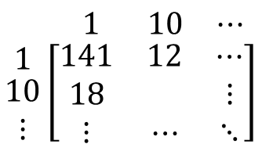
Matrix as K-Vs
Key |  |  |  |  | Value
Row | Column |  |  | Timestamp
 | Family | Qualifier | Visibility
Adjacency list view of Matrix
(Row, Column Qualifier, Value) = (v₁, v₂, weight) [Transpose: (v₂, v₁, weight)]
Example K-Vs
row :colq ->val 1 :1 [] -> 141 1 :10 [] -> 12 1 :101 [] -> 9 1 :105 [] -> 3 1 :11 [] -> 9 1 :110 [] -> 3 10 :1 [] -> 18 10 :109 [] -> 2 15 :1 [] -> 18 15 :109 [] -> 2
$$\begin{matrix} 1 & 10 & ⋯\end{matrix}$$
$$\begin{matrix}1 \\ \begin{aligned}10 \\ ⋮\end{aligned}\end{matrix}\left[\begin{matrix}141 & 12 & ⋯ \\ 18 & & ⋮ \\ ⋮ & ⋯ & ⋱\end{matrix}\right]$$
Other schemas supported:
Edge List / Incidence Matrix
Single Table with transpose & degrees
Notes:
I will try to
Let's start by showing how we represent a graph or matrix in Accumulo. In this work we use the adjacency matrix.
For each edge we store the starting vertex as the Accumulo row, the ending vertex as the Accumulo column qualifier, and the edge weight as the Accumulo value.
We may also store a transpose table where the row and column qualifier are switched.

Slide 18
Matrix as K-Vs
Key |  |  |  |  | Value
Row | Column |  |  | Timestamp
 | Family | Qualifier | Visibility
Adjacency list view of Matrix
(Row, Column Qualifier, Value) = (v₁, v₂, weight) [Transpose: (v₂, v₁, weight)]
Example K-Vs
row :colq ->val 1 :1 [] -> 141 1 :10 [] -> 12 1 :101 [] -> 9 1 :105 [] -> 3 1 :11 [] -> 9 1 :110 [] -> 3 10 :1 [] -> 18 10 :109 [] -> 2 15 :1 [] -> 18 15 :109 [] -> 2
Partition
by Row
$$\begin{matrix} 1 & 10 & ⋯\end{matrix}$$
$$\begin{matrix}1 \\ \begin{aligned}10 \\ ⋮\end{aligned}\end{matrix}\left[\begin{matrix}141 & 12 & ⋯ \\ 18 & & ⋮ \\ ⋮ & ⋯ & ⋱\end{matrix}\right]$$
Tablet 1
Tablet 2
Other schemas supported:
Edge List / Incidence Matrix
Single Table with transpose & degrees
Notes:
Partitioned by row.
Let's start by showing how we represent a graph or matrix in Accumulo. In this work we use the adjacency matrix.
For each edge we store the starting vertex as the Accumulo row, the ending vertex as the Accumulo column qualifier, and the edge weight as the Accumulo value.
We may also store a transpose table where the row and column qualifier are switched.

Slide 19
Accumulo Scan Iterator Pipeline
Goal: Understand Accumulo's support for in-database computation
in order to re-purpose it for analytics
In-Memory Map
Client
HDFS
RFile
RFile
…
Notes:
Now let's review Accumulo's dataflow, when a client scans an Accumulo table.
Data originates from Accumulo's in-memory map, for recently accessed data, or from sorted RFiles stored on disk in HDFS.

Slide 20
Accumulo Scan Iterator Pipeline
In-Memory Map
Merge
Client
HDFS
RFile
RFile
…
Notes:
Accumulo merges data from these sources together

Slide 21
Accumulo Scan Iterator Pipeline
User-defined SortedKeyValueIterators
In-Memory Map
Merge
Iterator 1
Iterator 2
Client
HDFS
RFile
RFile
…
Notes:
and sends them through a pipeline of user-defined iterators before sending them to the client.
These iterators are commonly used as filters, sums and simple transforms.

Slide 22
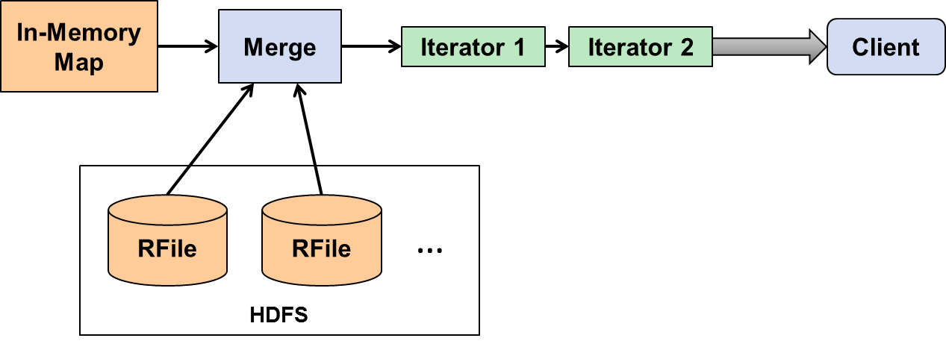
Accumulo BatchScan Iterator Pipeline
Tablet 1
Client
Tablet 2
1 :1 [] -> 141 1 :10 [] -> 12 1 :101 [] -> 9 10 :11 [] -> 9 --------------- 15 :1 [] -> 18 15 :109 [] -> 2
Tablet 3
Notes:
Scaling out, when a table grows large enough that it can be split into sections called tablets, different tablet servers process each tablet in parallel, running the same pipeline on different segments of data.
Here’s the question for us: how might we leverage the iterator infrastructure to perform the more complicated GraphBLAS matrix operations?

Slide 23
Graphulo addition to Iterator Pipeline
Scanner
Client
Use client-side Scanners and BatchWriters inside server-side iterators
BatchWriter
Table
Notes:
The key architectural insight is that inside these iterators we can open up Accumulo Scanners that read from another table
as well as Accumulo BatchWriters that write to another table.
Just like before, the reading and writing distributes with Accumulo across all its tablet servers.

Slide 24
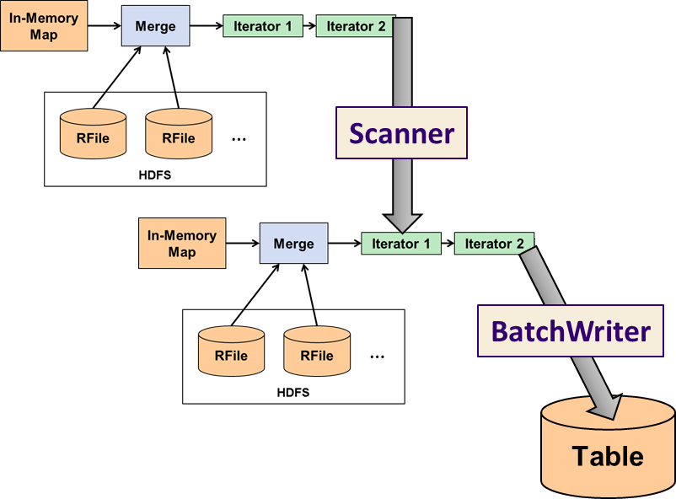
Graphulo addition to Iterator Pipeline
Distributes with Accumulo's Tablet Servers
Standing tablet server thread pools service queries interactively
Use client-side Scanners and BatchWriters inside server-side iterators
Notes:
Just like before, the reading and writing distributes with Accumulo across all its tablet servers.

Slide 25
Graphulo MxM: A^{T} (⊕.⊗) B
A^{T}
Client
Scanner
B
TwoTableIterator
RemoteWriteIterator
BatchWriter
C
Notes:
Let’s see how this enables matrix multiplication:

Slide 26
Graphulo MxM: A^{T} (⊕.⊗) B
A^{T}
(c₁, r₁, v₁)
Client
Scanner
(r₂, c₂, v₂)
B
TwoTableIterator
RemoteWriteIterator
BatchWriter
C
Notes:
As a reminder, here are the entries streaming from the source table.

Slide 27
Graphulo MxM: A^{T} (⊕.⊗) B
A^{T}
(c₁, r₁, v₁)
Client
Scanner
(r₂, c₂, v₂)
B
TwoTableIterator
RemoteWriteIterator
Align
c₁ = r₂
BatchWriter
(r₁, c₂, v₁ ⊗ v₂)
C
Notes:
The TwoTableIterator here aligns the entries along the Accumulo row, which matches the column of the first table and the row of the second table,
multiplies the corresponding values, and sends them to the result table C with a BatchWriter

Slide 28
Graphulo MxM: A^{T} (⊕.⊗) B
A^{T}
(c₁, r₁, v₁)
Client
Scanner
(r₂, c₂, v₂)
B
TwoTableIterator
RemoteWriteIterator
Align
c₁ = r₂
BatchWriter
(r₁, c₂, v₁ ⊗ v₂)
C
⊕
Notes:
A summing iterator on table C sums the partial products from the multiplication

Slide 29
Graphulo MxM: A^{T} (⊕.⊗) B (distributed)
Tablet of A^{T}
Key
Key
}
Imm In-Memory Map
Rfile Hadoop File
Imm
Rfile
Intra-process Data Flow
Network Data Flow
Scanner
Tablet of B
Imm
}
Tablet of C
flush
TwoTableIter
RemoteWriteIter
Imm
Rfile
⊗
⊕
Rfile
Tablet of A^{T}
BatchWriters
compact
Imm
}
⊕
Rfile
Scanner
Tablet of B
Imm
}
Tablet of C
flush
TwoTableIter
RemoteWriteIter
Imm
Rfile
⊗
⊕
Rfile
Illustrated: C = A^{T} (⊕.⊗) B each with two tablets
compact
⊕
Notes:
A summing iterator on table C sums the partial products from the multiplication

Slide 30
Graphulo Client Functions
long TableMult(String ATtable, String Btable, String Ctable)
long SpEWiseX(String Atable, String Btable, String Ctable)
long SpEWiseSum(String Atable, String Btable, String Ctable)
…
Simple API abstracts the iterator pipeline
Notes:
Graphulo presents matrix multiply as well as the other GraphBLAS operations as simple Java library calls,
when standard arithmetic plus and times are used and no other options are needed

Slide 31
Graphulo Client Functions
long TwoTable(
String ATtable, String Btable, String Ctable, String CTtable,
int BScanIteratorPriority, TwoTableIterator.DOTMODE dotmode,
Map<String, String> optsTT, IteratorSetting plusOp,
String rowFilter, String colFilterAT, String colFilterB,
boolean emitNoMatchA, boolean emitNoMatchB,
List<IteratorSetting> iteratorsBeforeA,
List<IteratorSetting> iteratorsBeforeB,
List<IteratorSetting> iteratorsAfterTwoTable,
Reducer reducer, Map<String, String> reducerOpts,
int numEntriesCheckpoint, Authorizations ATauthorizations, Authorizations Bauthorizations, int batchWriterThreads
)
Full control
when you need it
Notes:
When more advanced or custom functionality is needed, such as multiplying along the min.+ semiring
or when fusing kernels together to run at the same time, you can call the full Graphulo TwoTable API.
Don't be afraid of all the parameters; most accept -1 or null as default values.

Slide 32
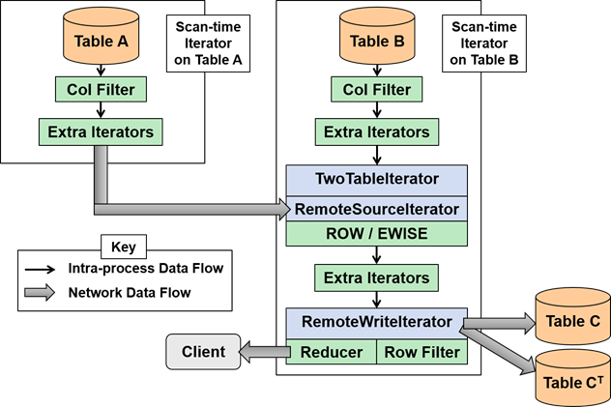
Graphulo’s TwoTable Pipeline
Notes:
You can think of TwoTable as filling in this iterator template. Different parts of the template are filled in based on the arguments to TwoTable.

Slide 33
Evaluating Graphulo
When is it better to use Graphulo vs. an external system?

Slide 34
Past Experiments
Compare Graphulo to
Single-node in-memory matrix libraries
D4M Sparse matrix library (MATLAB)
MTJ Dense matrix library (Java)
Itself
Benchmark of Graphulo scalability with cluster size
Notes:
One of Graphulo's use cases is analytics on a subgraph. Maximally uses the database's index. These subgraphs fit in memory. Natural to compare against in-memory systems. Comparison is on a single node out of fairness.

Slide 35
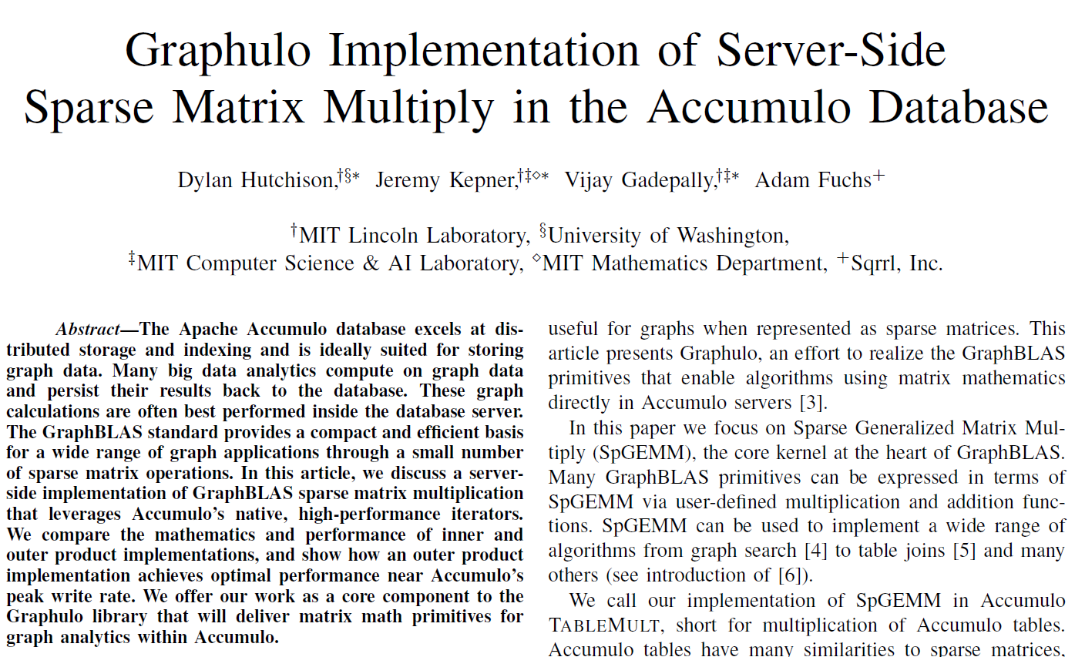
Past Exp: MxM Graphulo vs. D4M
2015
HPEC
Graphulo faster than single-node in-memory external systems on I/O-bound, single-pass computation
Task: Matrix Multiply (MxM)
Graphulo vs. D4M, Single-node
Result: Graphulo universally faster
Why?
I/O costs dominate (locality is good)
MxM can be formulated as a single-pass algorithm (use outer product)

Slide 36
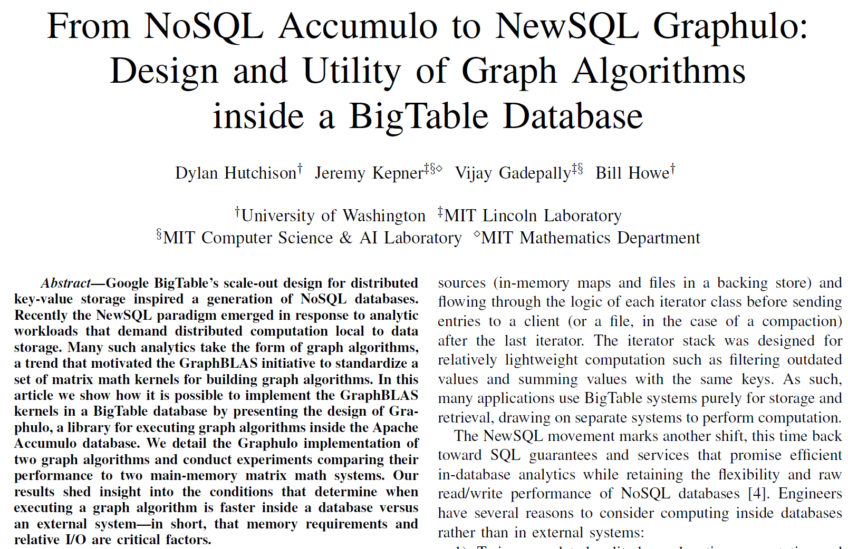
Past Exp: Jaccard, k-Truss graph algs.
2016
HPEC
Best Student Paper
Results hold for more complex graph algorithms
Tasks: Find Jaccard coefficients (vertex similarity), k-Truss subgraph (community detection)
Graphulo vs. D4M vs. MTJ
Result: Graphulo universally faster at Jaccard; D4M/MTJ universally faster at k-Truss
Why?
Jaccard can be expressed as a fused MxM
k-Truss iterations require one pass each
Accumulo writes intermediary tables to disk

Slide 37
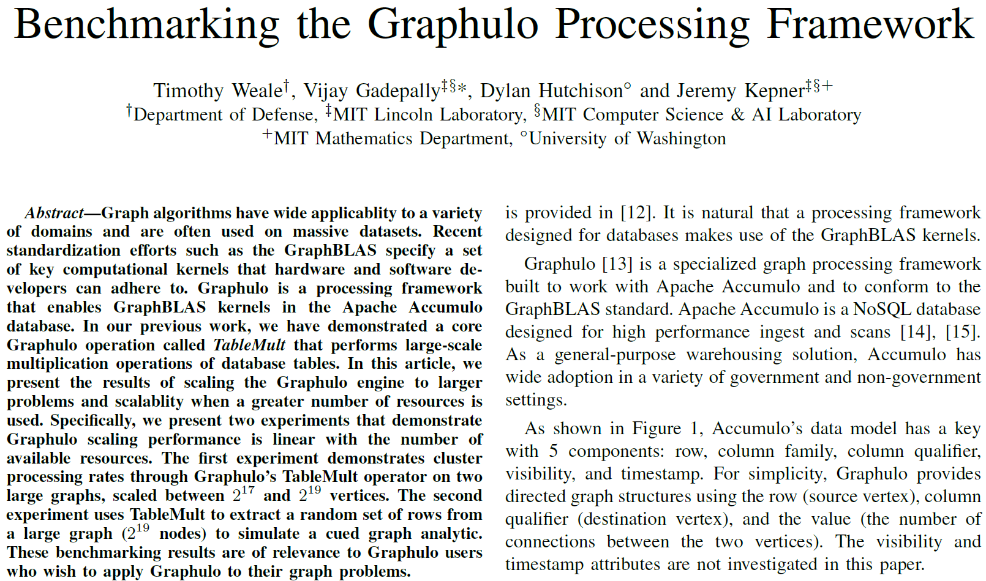
Past Exp: Benchmarking Graphulo
2016
HPEC
Graphulo scales with Accumulo as cluster size increases
Tasks: MxM, Subgraph Extraction
Graphulo Scalability Benchmark
Results: Linear weak & strong scaling on MxM. Subgraph extraction scales in interactive range
Why?
Graphulo designed to scale with Accumulo
(1-2k edge extraction)
Notes:
Scaled – Strong Scaling 17x17 to 19x19. Fixed – Weak Scaling 18x18. Relative to one tablet server. Two tablets per node.
"Kink" due to Java-managed in-memory maps. Deployment issue.
2x data != 2x time. Interactive. There is another graph not shown here for the scaled (strong) experiment on subgraph extraction.

Slide 38
Past experiments compare Graphulo to itself & to in-memory single-node external systems.
Where's the experiment comparing Graphulo to distributed external systems?
(answer: this talk)

Slide 39
MxM: Graphulo vs. MapReduce
MapReduce well supported by Accumulo
"Use Accumulo for low-latency queries on subgraphs"
"Use MapReduce for high-throughput analytics"
Are these assumptions true?
MapReduce C = A^{T}B (see next slide)
Map phase: BatchScan & Join A^{T}, B on their common key
Reduce phase: Multiply, BatchWrite partial products
# of reducers not a major factor
Disable speculative execution for correctness
Sum partial products via iterator on C
Very similar to Graphulo code, except more room to optimize (earlier projection, loop fusion, fewer copies)
Notes:
We wrote the Graphulo software with low-latency queries in mind. After all, databases are designed to index your data, which means fast access to subsets of data along your access path. But how would it perform on whole-table analytics? Except for the behavior that Accumulo writes to disk, which matters in the case of >1 iterations, Graphulo was designed to scale to any problem size and any cluster size.

Slide 40
MapReduce C = A^{T} (⊕.⊗) B
Key
Tablet of A^{T}
External Process
Imm In-Memory Map
Rfile Hadoop File
Key
Imm
}
Mapper
Accumulo
Iterator
Intra-process Data Flow
Rfile
Network Data Flow
Tablet of B
Imm
}
Tablet of C
flush
Mapper
Reducer
Imm
Rfile
⊗
⊕
Scanners
Shuffle
Rfile
Tablet of A^{T}
BatchWriters
}
compact
Imm
⊕
Mapper
Rfile
Tablet of C
flush
Tablet of B
Reducer
Imm
Imm
}
⊗
⊕
Mapper
Rfile
Rfile
compact
⊕
Illustrated: C = A^{T} (⊕.⊗) B each with two tablets, two Reducers
Notes:
The Scanners going into the mappers are actually BatchScanners. They have 1 thread, so they act the same as Scanners.

Slide 41
Graphulo C = A^{T} (⊕.⊗) B (reminder)
Tablet of A^{T}
Key
}
External Process
Imm In-Memory Map
Rfile Hadoop File
Key
Imm
Rfile
Accumulo
Iterator
Intra-process Data Flow
Network Data Flow
Scanner
Tablet of B
Imm
}
Tablet of C
flush
TwoTableIter
RemoteWriteIter
Imm
Rfile
⊗
⊕
Rfile
Tablet of A^{T}
BatchWriters
compact
Imm
}
⊕
Rfile
Scanner
Tablet of B
Imm
}
Tablet of C
flush
TwoTableIter
RemoteWriteIter
Imm
Rfile
⊗
⊕
Rfile
Illustrated: C = A^{T} (⊕.⊗) B each with two tablets
compact
⊕
Notes:
A summing iterator on table C sums the partial products from the multiplication

Slide 42
MxM: Graphulo vs. MapReduce
Hardware & Setup
12 x m3.large nodes on Amazon EC2, $38/day
7.5 GB memory, 2 vCPUs, 30 GB SSD per node
8 worker tablet servers
3 GB memory for Accumulo, 3 GB for YARN
One tablet per node (low intra-node parallelism)
3 coordinator nodes (YARN ResourceManager, Accumulo Master, HDFS NameNode, Zookeeper)
1 metric-monitoring node (Grafana with InfluxDB)
Graph500 Power law matrix generator
From 2¹⁰ to 2¹⁹ rows, 16 non-zeros/row, in each input
Skew!
Notes:
We wrote the Graphulo software with low-latency queries in mind. After all, databases are designed to index your data, which means fast access to subsets of data along your access path. But how would it perform on whole-table analytics? Except for the behavior that Accumulo writes to disk, which matters in the case of >1 iterations, Graphulo was designed to scale to any problem size and any cluster size.

Slide 43
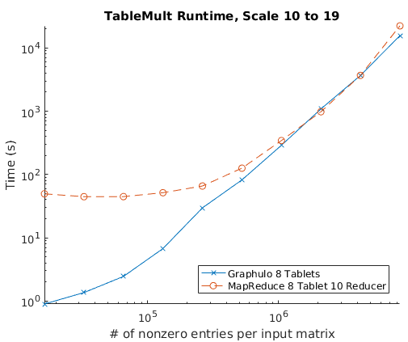
MxM: Graphulo vs. MapReduce
Convergence
at larger inputs
Huge YARN
startup cost

Slide 44
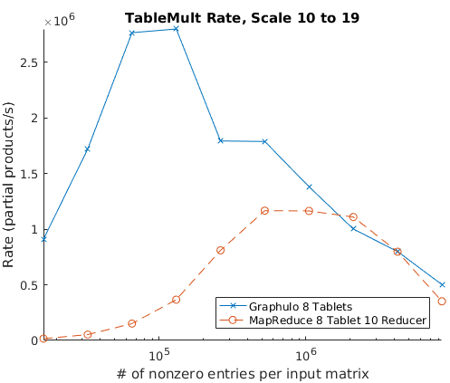
MxM: Graphulo vs. MapReduce
Convergence
at larger inputs
Sustained Ingest:
compactions throttle Accumulo
Burst
Ingest
Huge YARN
startup cost

Slide 45
When to use Graphulo?
Use Graphulo for I/O-bound single-pass analytics
Big speedup for smaller problem sizes
Equivalent at larger problem sizes
Holds against external in-memory processing (D4M, MTJ matrix libraries) & distributed (MapReduce)
Use an in-memory system for CPU-bound or multi-pass analytics
k-Truss task: expressed as a graph algorithm that loops over GraphBLAS kernels
Horrible to write each intermediary table to disk
Yet, even HPC systems write checkpoints
Notes:
Unlikely Spark would make a difference, but you can't say for sure without running the experiment.

Slide 46
RACO: Relational Algebra for Apache Accumulo
π σ ⋈ γ ∪

Slide 47
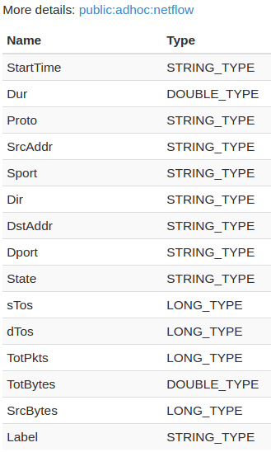
How to model a relation in Accumulo?
Key |  |  |  |  | Value
Row | Column |  |  | Timestamp
 | Family | Qualifier | Visibility
Relations have lots of attributes
More choices than with matrices
Graphulo: adjacency, incidence, single-table schemas
Choice affects partitioning
Should work for any Accumulo data

Slide 48
Accumulo Access Paths "in the wild"
Presto
Hive
Pig
Rya
Giraffe
GeoMesa
GeoWave
Timely
Gora
Graphulo
D4M
Data Model
Relational
RDF Triple
Graph
Spatiotemporal
Array
Event
Object-relational mapping
Matrices
Accumulo
Table
Index
Index

Slide 49
Accumulo Access Path "Physical Schema"
For each family, divide attributes into three parts:
DAP | LAP | VAP
DAP: Distributed Access Path
How data is partitioned across servers; null disallowed
LAP: Local Access Path
How data is sorted within a server; null disallowed
VAP: Value Access Path
Other attributes, unsorted; null allowed
Key |  |  |  |  | Value
Row | Column |  |  | Timestamp
 | Family | Qualifier | Visibility
DAP
__FAMILY__
LAP
VAP__VIS
VAP__TS
VAP
Notes:
DAP & LAP are lists, VAP is a set. Special attributes at the bottom.

Slide 50
Access Path Netflow Example
DAP | LAP | VAP
TotBytes, StartTime | | SrcAddr, DstAddr, Dur
Each tuple is a set of Key-Values
Facilitates projection, filtering, missing values
Key |  |  |  |  | Value
Row | Column |  |  | Timestamp
 | Family | Qualifier | Visibility
09:46:59.607825,276 "" "" public 145635001 DstAddr|94.44.127.113
09:46:59.607825,276 "" "" public 145635001 Dur|1.026539
09:46:59.607825,276 "" "" public 145635001 SrcAddr|147.32.84.59
Notes:
Want to learn more? Ask me about LARA.

Slide 51
Compiling RA onto Accumulo
Accumulo Tasks
RACO Logical Plan
Store(B)
Apply
Expression
Select
Condition
Scan(A)
Notes:
Think Myria Fragments
Top-down compilation process
FileScan -> iterator that reads a file in CSV schema

Slide 52
Compiling RA onto Accumulo
AccumuloPipelineTask
Table A
Accumulo Tasks
Tuple to KV
RACO Logical Plan
RemoteWriteIterator
Table B
Store(B)
CreateTableTask
Table B
ApplyIterator
Apply
Java Function
Expression
Select
RowRangeIterator
Row Condition
Condition
Scan(A)
AccumuloBase
KV to Tuple
Notes:
Think Myria Fragments, especially for Joins. AccumuloPipelineTask serialized and transmitted to the BatchScan of Table A.
Top-down compilation process
FileScan -> iterator that reads a file in CSV schema

Slide 53
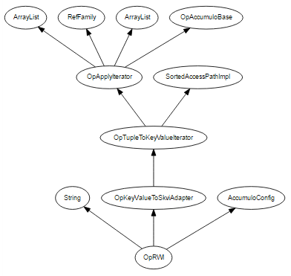
Takeaways from RA on Accumulo
Polystore Demo
RA Compilation used in an October sponsor demo
Federated plan executed part Accumulo, part Spark or C
Accumulo query stored results in a CSV file for Spark/C
"Prototype works!" Much more to do…
Notes:
primitive is the Block – store a contiguous range of entries together. Unspecified how contiguous blocks are stored.
Block[1]

Slide 54
Takeaways from RA on Accumulo
Access Paths hint at a general physical schema
Primitives
Block[n](…): Store contiguous range of n entries together
Group(…): Each entry stored separately; Block[1]
Range(…): All entries stored together; Block[N]
Examples
Accumulo: Block(row) Group(family) Range(row, family, qualifier, visibility, timestamp) value
Myria hash partitioning: Group(a₁, ..., a_{k}) a₁, ..., a_{k}
TileDB matrix: Block(j, i) Range(i, j) v
More access paths for indices
Applications pick both a logical & physical schema
Notes:
primitive is the Block – store a contiguous range of entries together. Unspecified how contiguous blocks are stored.
Block[1]

Slide 55
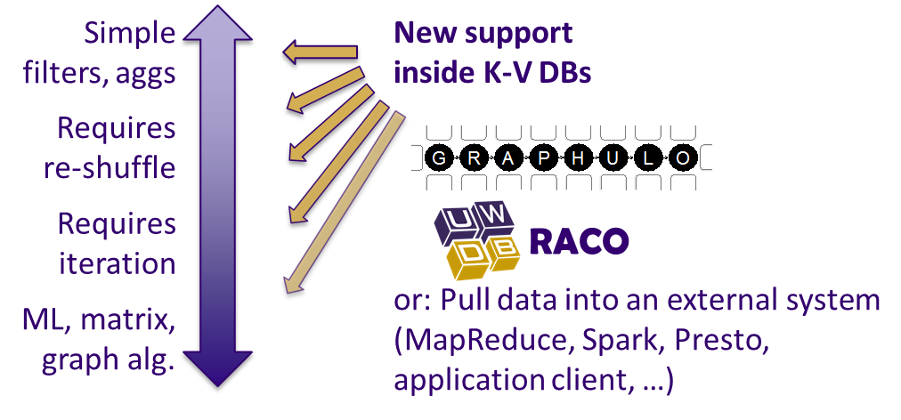
In-Database Analytics for K-V DBs
Graphulo: LA on K-V DBs
Graphulo vs. MapReduce experiment
Comparable at scale; in-DB dominates "scale down"
Use in-DB approach for I/O-bound single-pass analytics
RACO: RA on K-V DBs
Access Paths helpful as a "physical schema"
Compiles into Accumulo iterators
Future: A Polystore Cross-Platform Optimizer

Slide 56
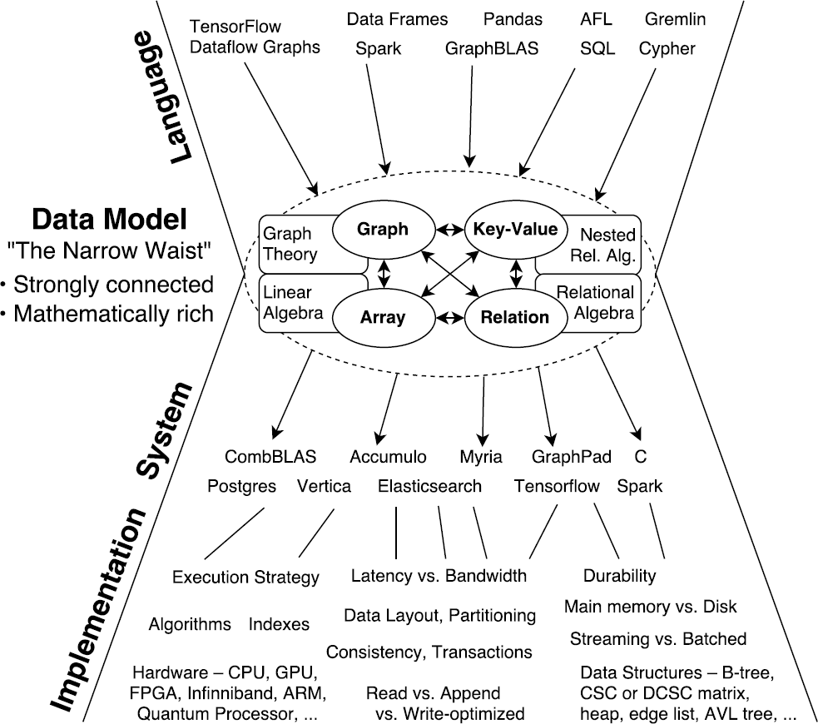
Why does LA, RA work on K-V DBs?
Notes:
Want to learn more? Ask me about LARA.

Slide 57
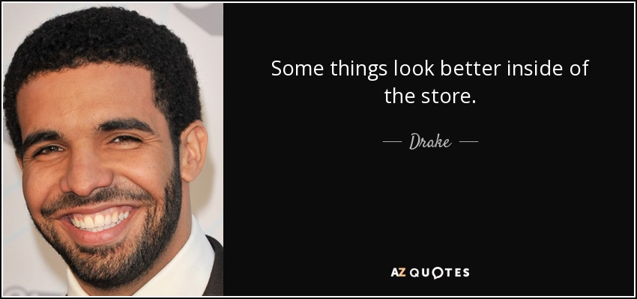
Notes:
ironic – he means that inside a shopping store, some items look better than what they actually are when you buy them.

Slide 58
Backup Slides

Slide 59
Background on Accumulo
Key |  |  |  |  | Value
Row | Column |  |  | Timestamp
 | Family | Qualifier | Visibility
Best for:
Large, de-normalized tables; no schema necessary
Unlimited columns; un-interpreted values; everything is a byte[]
TBs to PBs of data; robust horizontal scaling
Hadoop HDFS / Java ecosystem
Cell-level access control
Row store by default
Scan over rows for O(log n) lookup & sorted order
Maintain "Transpose Table" for column-major access path
Iterator processing framework
Notes:
Skip through this
Locality groups on column families work if you know what the columns are in advance

Slide 60
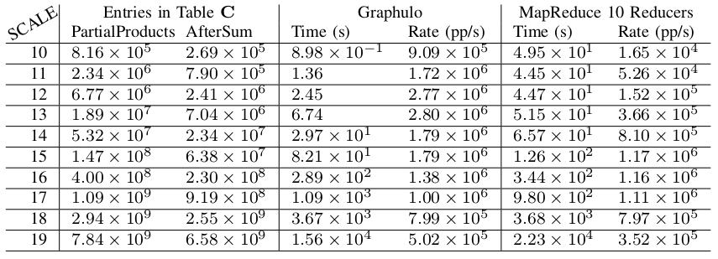
MxM: Graphulo vs. MapReduce
Table of Results

Slide 61
Past Experiments
Compare Graphulo to
Single-node in-memory matrix libraries
D4M Sparse matrix library (MATLAB)
MTJ Dense matrix library (Java)
Itself
Benchmark of Graphulo scalability with cluster size
Tasks:
Matrix Multiply (MxM), the backbone of LA
Subgraph Extraction, via MxM with a cue table
Jaccard Coefficients, a vertex similarity metric
k-Truss Subgraph, used to detect communities
Notes:
One of Graphulo's use cases is analytics on a subgraph. Maximally uses the database's index. These subgraphs fit in memory. Natural to compare against in-memory systems. Comparison is on a single node out of fairness.

Slide 62
2015 HPEC: MxM, single-node
Graphulo vs. D4M (MATLAB sparse matrix library)
Result: Graphulo universally better
2016 HPEC: Jaccard, k-Truss, single-node
Graphulo vs. D4M vs. MTJ (Java dense matrix library)
Result: Graphulo universally better at Jaccard; D4M/MTJ universally better at k-Truss
2016 HPEC: MxM, subgraph extraction, cluster
Graphulo vs. itself on increasing cluster size
Result: Linear weak & strong scaling on MxM Subgraph extraction scales, in interactive range

Slide 63
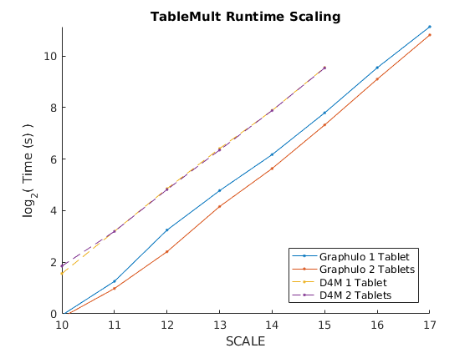
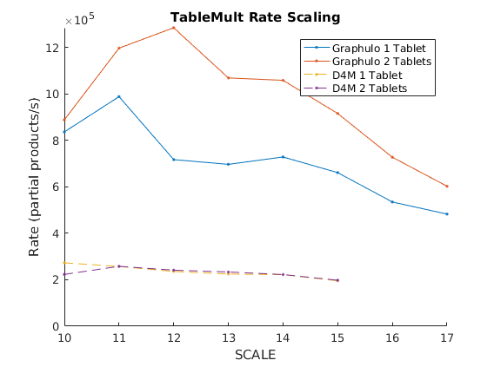
MxM Single-Node Experiment

Slide 64
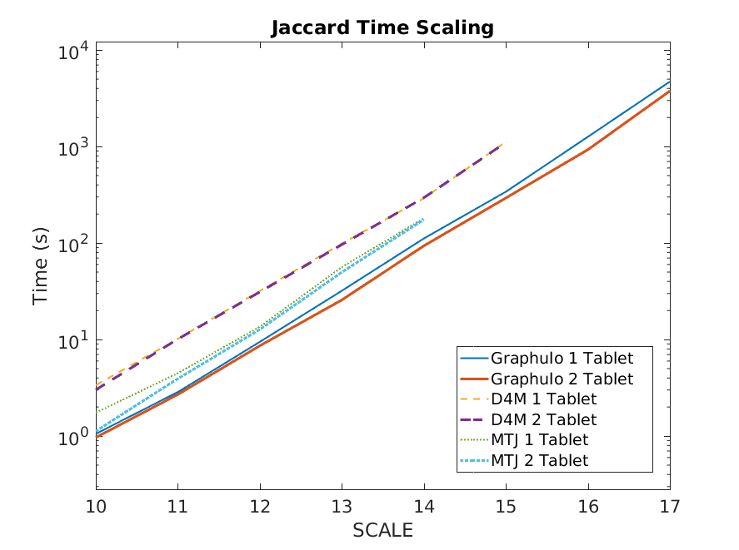
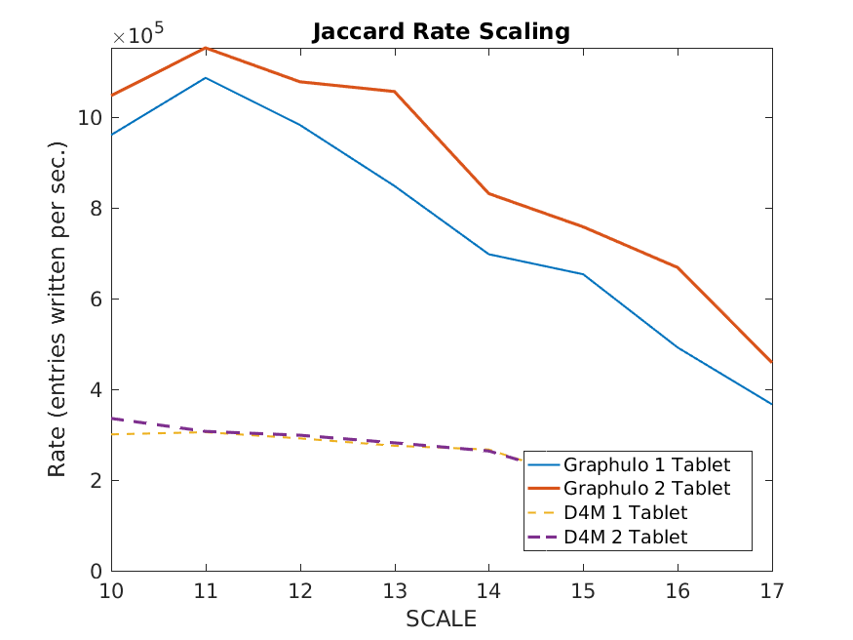
Jaccard Experiment Graphs

Slide 65
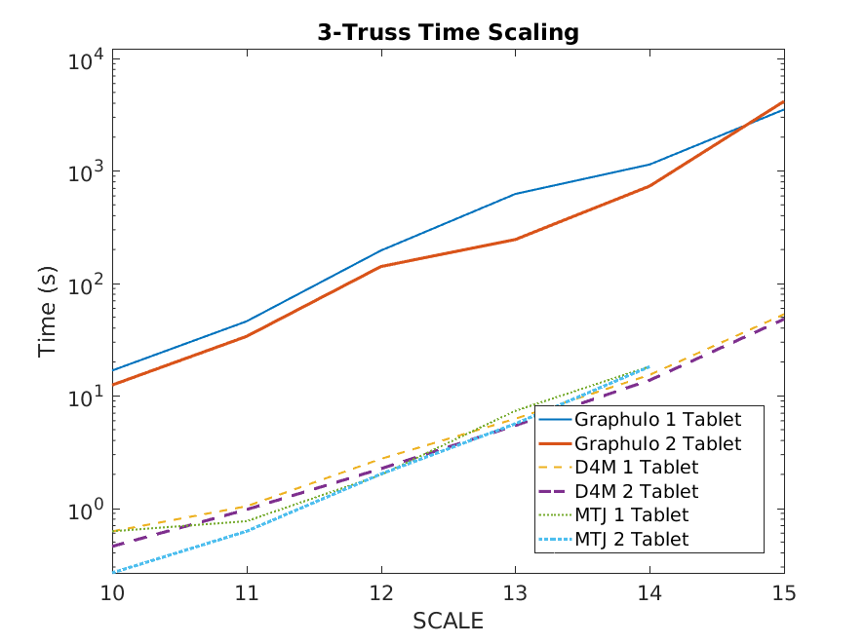
3-Truss Experiment Graph
Some points may
need re-evaluating

Slide 66
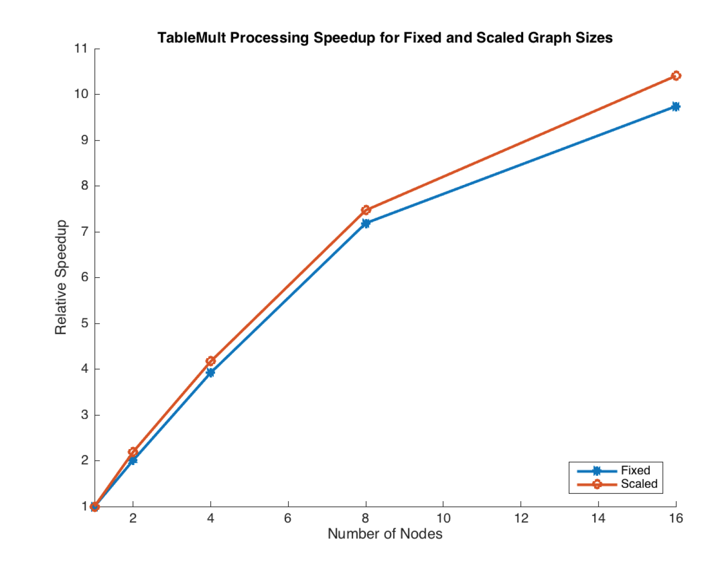
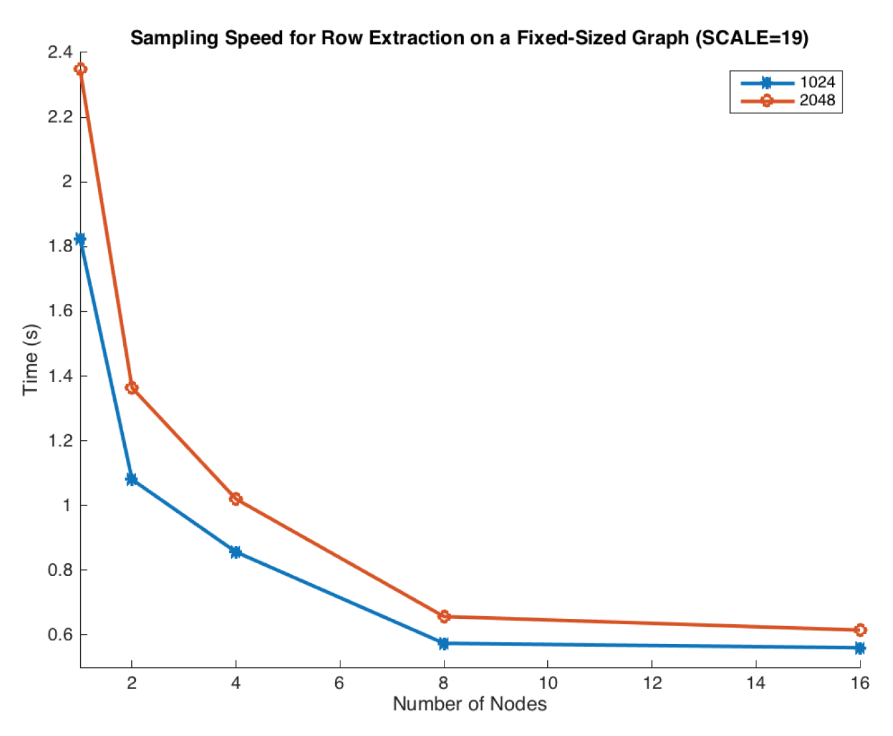
Past Exp: Benchmarking Graphulo
Subgraph extraction scales; interactive time
Overall MxM scales linearly, strong & weak
Notes:
Scaled – Strong Scaling 17x17 to 19x19. Fixed – Weak Scaling 18x18. Relative to one tablet server. Two tablets per node.
"Kink" due to Java-managed in-memory maps. Deployment issue.
2x data != 2x time. Interactive. There is another graph not shown here for the scaled (strong) experiment on subgraph extraction.

Slide 67
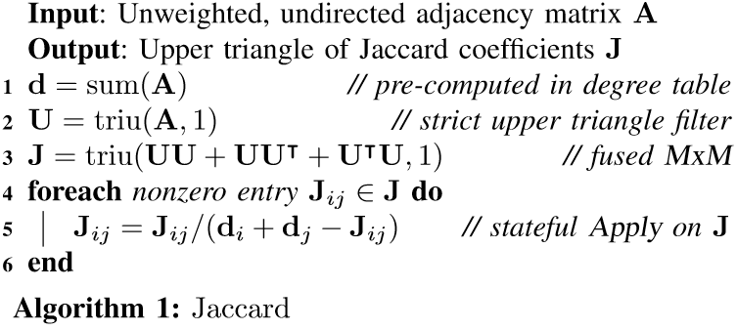
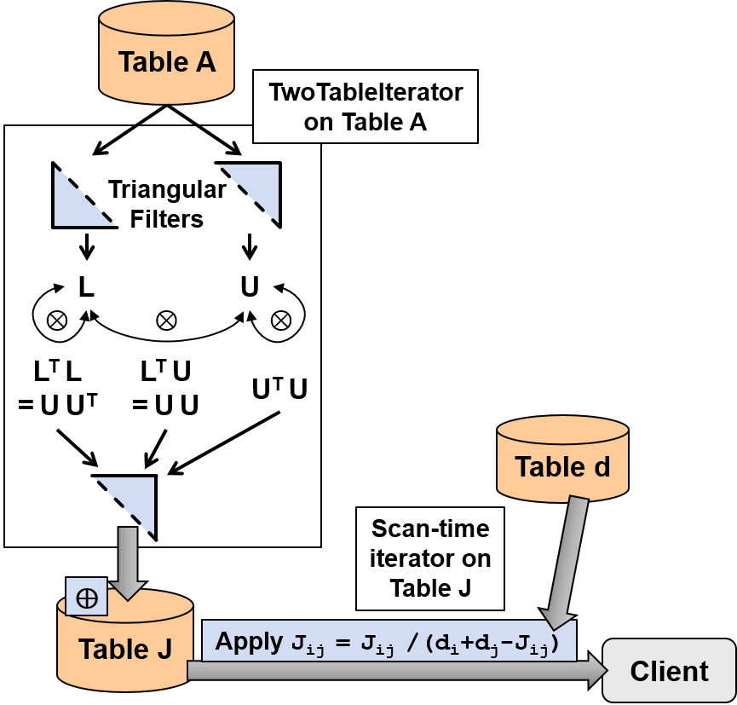
Alg 1: Jaccard Coefficients
Fusion:
A single Graphulo TwoTable pass!
Note! This has been improved
since the HPEC paper. Doable
as a special OneTable operation.

Slide 68
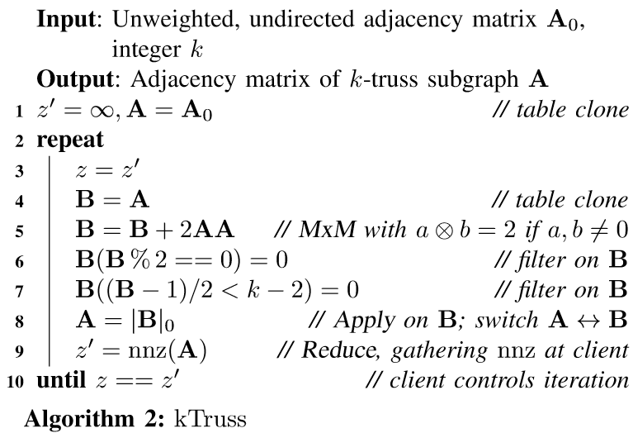
Alg 2: k-Truss Subgraph
A
deepCopy()
TableMult
⊗2
B % 2 = 1 && (B - 1) / 2 ≥ k-2
B
nnz
Client
Iterations of Graphulo TwoTables

